Slide 1
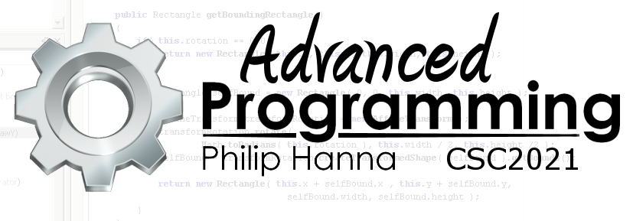
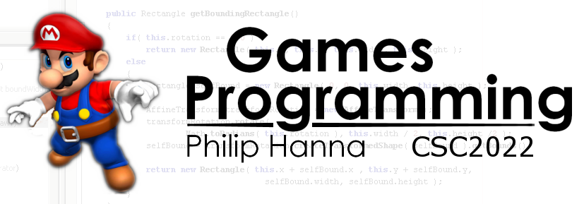
Collision Avoidance
Enabling game entities to detect and avoid collisions.

Slide 2
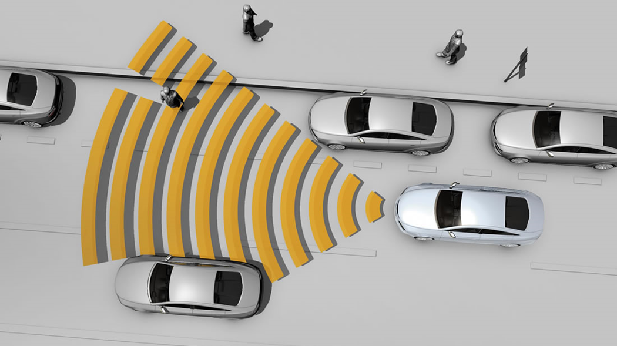
Collision Avoidance

Slide 3
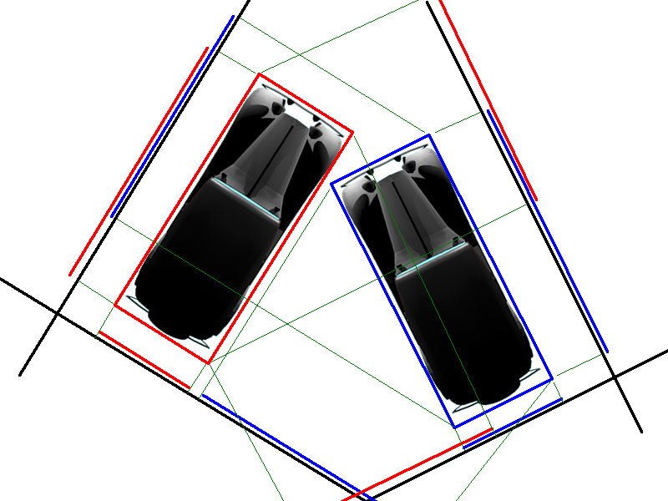
Where there is a lot of independent game objects moving in the same space it will likely be necessary to provide some form of collision avoidance.
One approach to collision avoidance is to trigger an evade or separate steering behaviour if a predicted collision is detected.

Slide 4
: Predicting Collisions
A future collision can be detected by determining the future path of two objects based on current velocities.
The closest distance of approach can be calculated and action triggered if the distance is less than some threshold (e.g. combined bounding radii × comfort factor)
Point of closest approach
Point of closest approach
Closest distance
Object 1
Object 2
Note: The point of closest approach may not be where the trajectories cross as different objects with different velocities reach the point at different times.

Slide 5



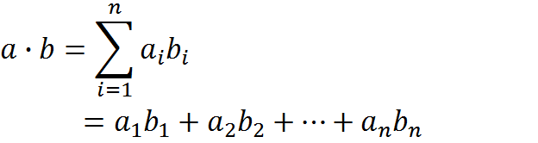


: Predicting Collisions
The time of closest approach can be calculated as:
v₂
v₁
d_{v}
v₁
p₁
v₂
p₂
The points of closest approach are then given by:
d_{p}
Object 1
Object 2
If the time of closest approach is negative then the objects are moving away from each other, and no action is needed.

Slide 6
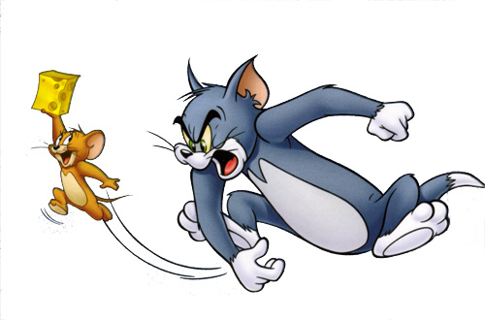
: Detection Response
If a collision has been detected, then the predicted future locations are used to derive the evade or separate behaviour (and not the current positions)
For multiple predicted collisions, the object with the closest predicted time of collision should be reacted to first.
Note: If the point of collision will occur at the centre of both objects (unlikely, but maybe possible) then evade, etc. will not work. A special case is needed to handle this situation, e.g. evading on the current positions, etc.

Slide 7
foreach( Object target in targets ) {
Vector relPos = target.position – source.position;
Vector relVel = target.velocity – source.velocity;
float relSpeed = relVel.length();
float relDistance = relPos.length();
float timeToCollide
= Math.dot(relPos, relVel)
/ (relSpeed * relSpeed );
float minSep =
relDistance – relSpeed * timeToCollide;
if( minSep < source.radius + target.radius )
if( timeToCollide > 0 AND
timeToCollide < closestTime ) {
// Store closestTarget, closestTime, ...
}
}
targets all Objects to avoid
CollisionAvoidance(
Object source, Array targets) {
Object closestTarget = null;
float closestTime = float.max;
float closestSep, closestDis;
// Determine closest target
if( closestTarget == null ) return;
if( closestSep <= 0 || closestDis < source.radius + closestTarget.radius )
return Evade( source.position,...);
else {
return Evade( source.position +
source.velocity * closestTime, ... );
}
If already in collision, or exact centre hit then steer away from current position, else use predicted location.
Determine time to collide
If collision and closest so far, then store

Slide 8
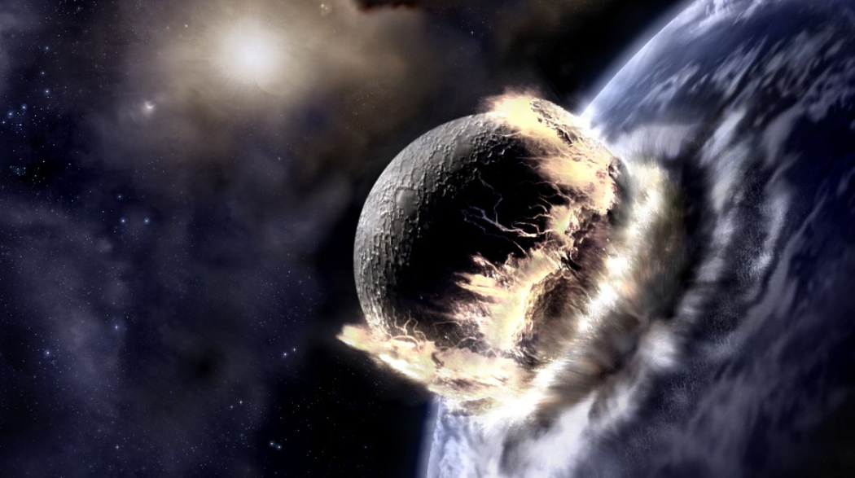
Large Objects: Collision Avoidance

Slide 9
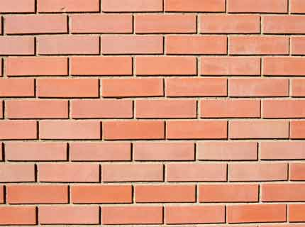
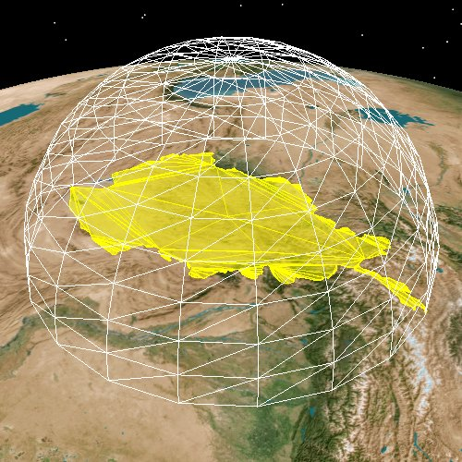
: Walls and Large Objects
The previous algorithm assumes a circular/spherical bound (applicable to lots of objects).
For large irregular objects or rectangular objects (e.g. walls) a bounding sphere can offer a poor bound (a large volume around the object will be needlessly avoided).

Slide 10

: Ray Casting
A suitable approach for walls, etc. involves casting one or more rays in the direction of travel. The rays will have a defined maximum length.
If the rays collide with an object then a movement target is created to avoid the collision, and a Seek made towards the target.
Cast ray
Point of collision
Normal to collision
Seek target to avoid collision

Slide 11
: Ray Casting
ObstacleAvoidance(
Object source, CollisionDetector detector ) {
float avoidDistance;
float lookaheadDistance;
Vector ray = source.velocity;
ray.normalize();
ray *= lookaheadDistance;
CollisionInfo collision =
detector.getCollision(source.position, ray)
if( collision == null ) return;
Vector targetPosition = collision.position
+ collision.normal * avoidDistance;
return Seek( source.position, targetPosition )
A CollisionDetector is assumed to be an object that has awareness of the level geometry and can test for object/ray intersection – returning at least an intersection point and normal vector.
Note: Developing a fast and efficient collision detection system can be a sizeable undertaking. For more information see:
http://en.wikipedia.org/wiki/Collision_detection
http://www.realtimerendering.com/intersections.html
CollisionInfo is assumed to hold information on any detected collision(s).

Slide 12
: Ray Configuration
Collision not detected
A single cast ray may not avoid an obstacle. Other options include:
Parallel side rays – good for tight passages, susceptible to the corner trap.
Central ray with short whiskers – need to cast three rays, not good for very tight passages.
Whiskers only – ‘blind spot’ close to object, not good for tight passages
Parallel side rays
Corner trap – collision avoidance cancels out
Central ray, side whiskers
Whiskers

Slide 13

Key takeaways:
By casting rays in front of the game object it becomes possible to detect and react to many obstacles within the environment.

